Slide 1

An English Chatbot
Presented by Kosisochukwu Akaeze

Slide 2
Outline
Introduction
Application of Deep Learning
Objective of project
Procedure
Sequence -To- Sequence Model
Results, Conclusions

Slide 3
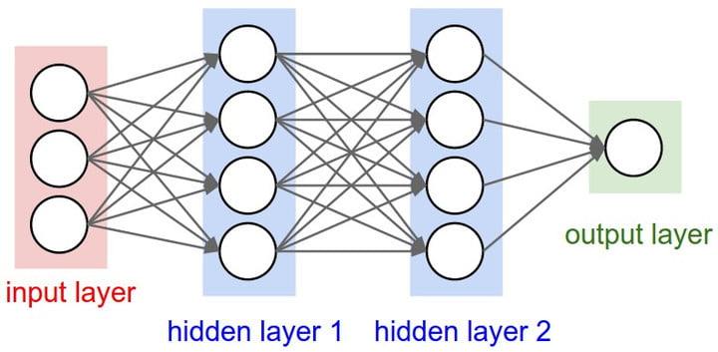
Introduction
Deep Learning - Neural Networks
Artificial Neural Networks are brain-inspired systems which are intended to replicate the way we humans learn.
Neural networks consist of input and output layers, as well as (in most cases) a hidden layer consisting of units that transform the input into something that the output layer can use.

Slide 4
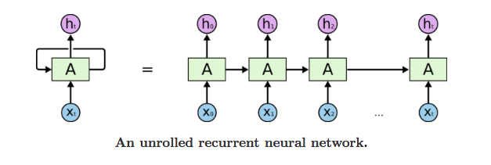
Introduction
Recurrent Neural Networks (RNN)
Recurrent neural networks (RNN) is a multiple copy of the same network that receives input (from outside and from its preceding network’s hidden layer ) at different times.

Slide 5
Application of Deep Learning

Slide 6
Objective of project
Create a Chatbot that speaks English
The chatbot should be able to make coherent statements
Find a reliable corpus to train your model on.
Deploy the model

Slide 7
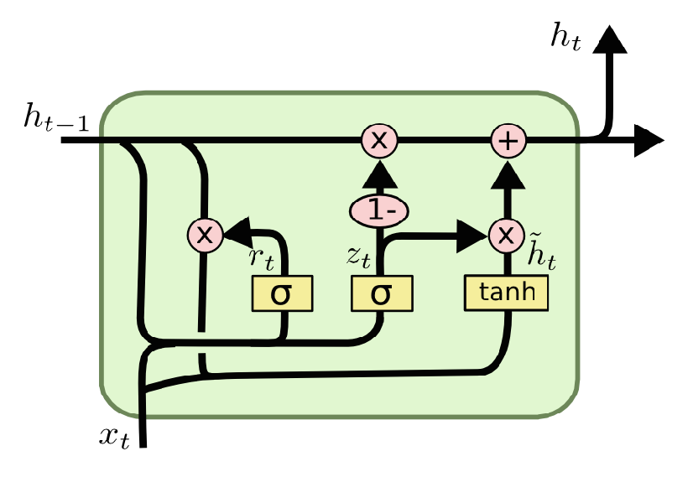
Procedure
Gated Recurrent Unit (GRU)
GRU is a gating mechanism in RNN, wish tries to solve the vanishing gradient problem that comes with standard RNN.
GRU solves the vanishing gradient problem by using an update gate and a reset gate.
The update gate controls information that flow into the memory.
The reset gate controls information that flow out of the memory.

Slide 8
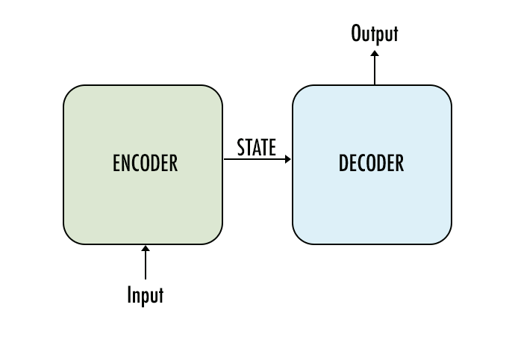
Sequence -To- Sequence Model
A typical sequence to sequence model has two parts – an encoder and a decoder.
The encoder takes the input and interprets it in a way the model understands.
The decoder takes the comprehensible input from the encoder and provides an answer to the input(e.g. a translation model outputs the input in a different language)

Slide 9
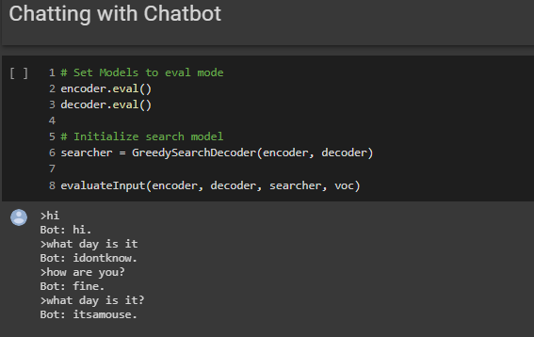
Result, Conclusion
The chatbot was able to form coherent sentences
It’s response didn’t always match the question asked.
The context vector needs to improve.
A solution to this could be training the model with data for specifics scenarios, for e.g. A customer service chatbot should be trained on a corpus made up of customer service conversatons.

